Slide 1
Optimization Algorithms : Glowworm Swarm Algorithm
Presented By:
Arijeet Satapathy (B416014)
Seva Mahapatra (B416044)
Ritesh Kumar Pandey (B416063)

Slide 2
Glowworm Swarm Optimization Algorithm

Slide 3
INTRODUCTION
Swarm intelligence (SI) is a type of artificial intelligence, based on the collective behavior of decentralized, self- organized systems. It focuses on the study of the collective behavior that is made up of a population of simple agents interacting locally with one another and with their environment.
The main idea:
This algorithm is derived from natural glowworm’s activities in the night, the glowworm exercise in group, they interact with each other by one’s luciferin. If the glowworm emits more light, it can attracts more glowworms towards it.

Slide 4
Start
FLOWCHART
Initialization of glowworms position and local decision range
Evaluate glowworms fitness
For each iteration, t
For each glowworm, i
Update glowworms luciferin value
Update movement of glowworm by using probabilistic mechanism
Update glowworms decision range by using neighborhood range update rule
Is termination criteria met ?
NO
YES
End

Slide 5
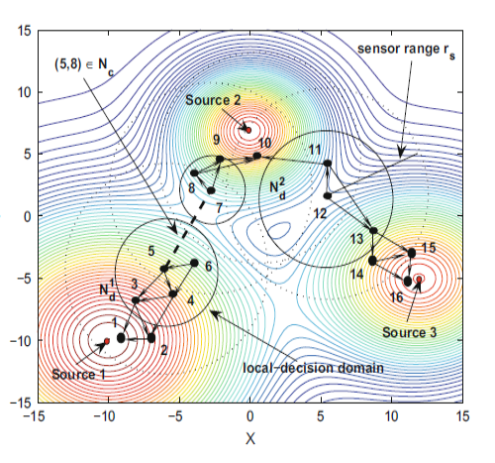
Fig : Movement of Glowworm to their Local Optima

Slide 6

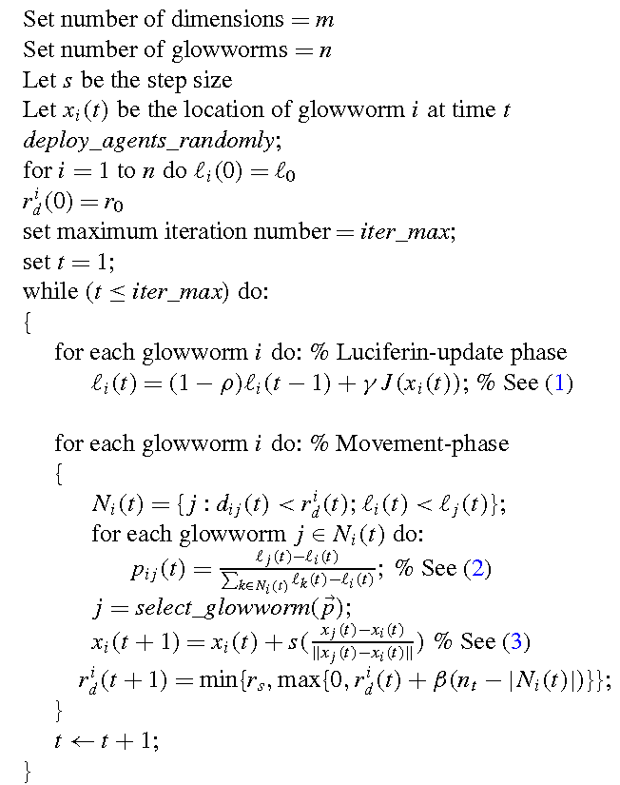
GSO
Pseudocode

Slide 7
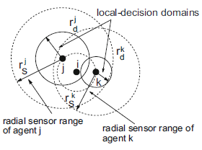
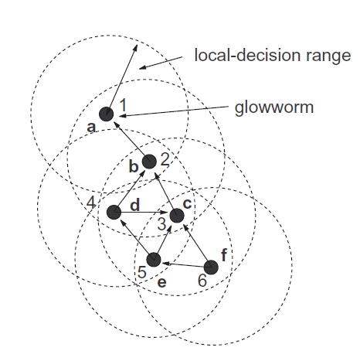

Slide 8
Phase 1
Luciferin Update Phase
The luciferin update rule is:
l_{i}(t + 1) = (1 − ρ)l_{i} (t) + γ J (x_{i} (t + 1))
l_{i} represent the luciferin level associated with glowworm i at time t, l₀ is ρ is the luciferin decay constant (0 < ρ < 1),
γ is the luciferin enhancement constant.
J (x_{i} (t)) represents the value of the objective function at glowworm i ’s location at time t.

Slide 9
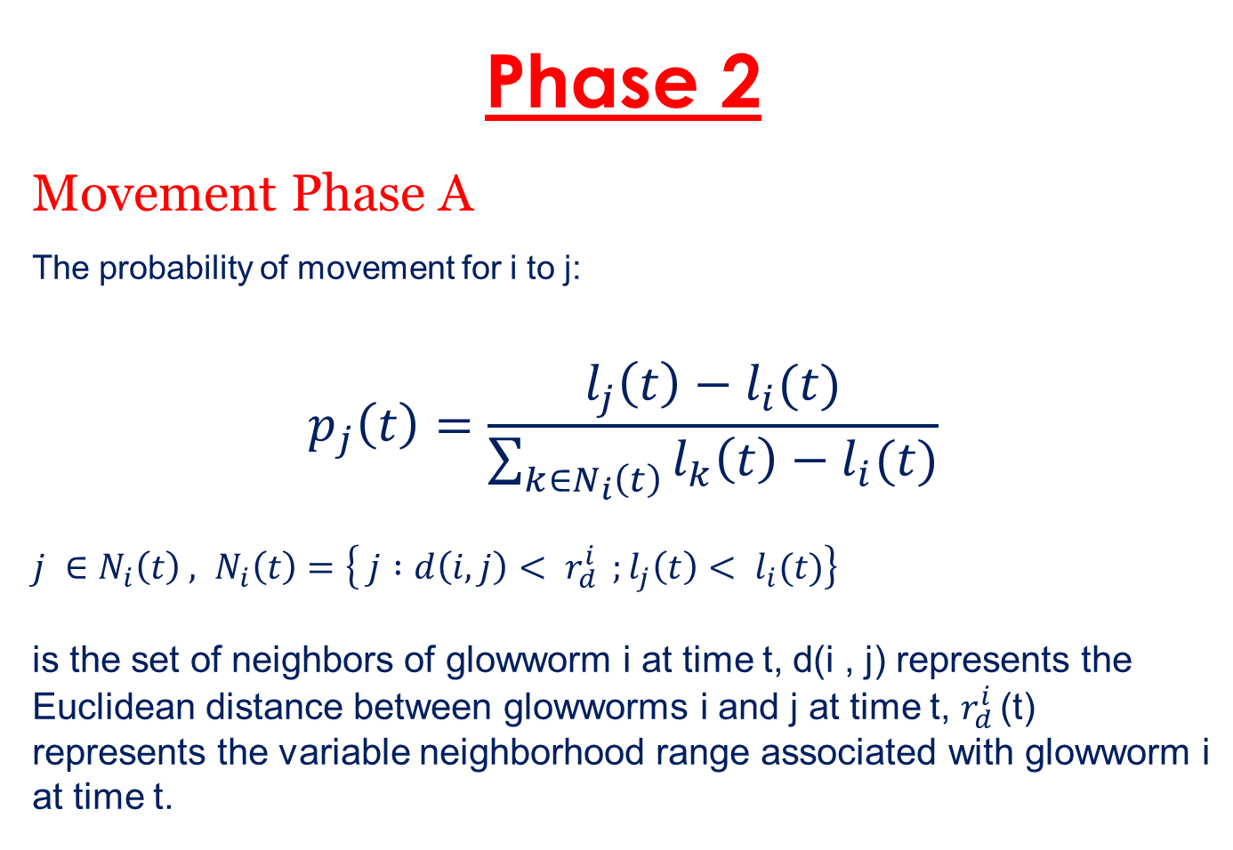
Phase 2
Movement Phase A
The probability of movement for i to j:
$$p_{j}\left(t\right)=\frac{l_{j}\left(t\right)−l_{i}(t)}{\sum_{k∈N_{i}\left(t\right)}{l_{k}\left(t\right)−l_{i}(t)}}$$
$j ∈N_{i}\left(t\right) , N_{i}\left(t\right)=\left\{ j :d\left(i,j\right)< r_{d }^{i} ;l_{j}\left(t\right)< l_{i}(t)\right\}$
is the set of neighbors of glowworm i at time t, d(i , j) represents the Euclidean distance between glowworms i and j at time t, $r_{d }^{i}$(t) represents the variable neighborhood range associated with glowworm i at time t.

Slide 10
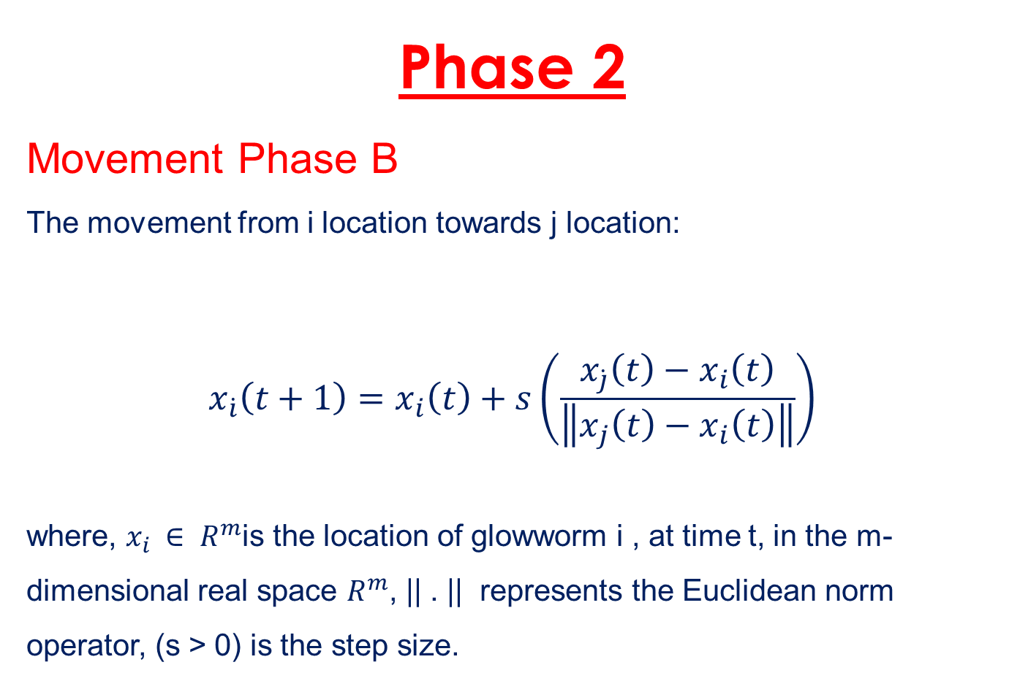
Phase 2
Movement Phase B
The movement from i location towards j location:
$$x_{\dot{i}}\left(t+1\right)=x_{i}\left(t\right)+s\left(\frac{x_{\dot{j}}\left(t\right)−x_{i}\left(t\right)}{\left\|x_{j}\left(t\right)−x_{i}\left(t\right)\right\|}\right)$$
where, $x_{i }∈ R^{m}$is the location of glowworm i , at time t, in the m-dimensional real space $R^{m}$, || . || represents the Euclidean norm operator, (s > 0) is the step size.

Slide 11
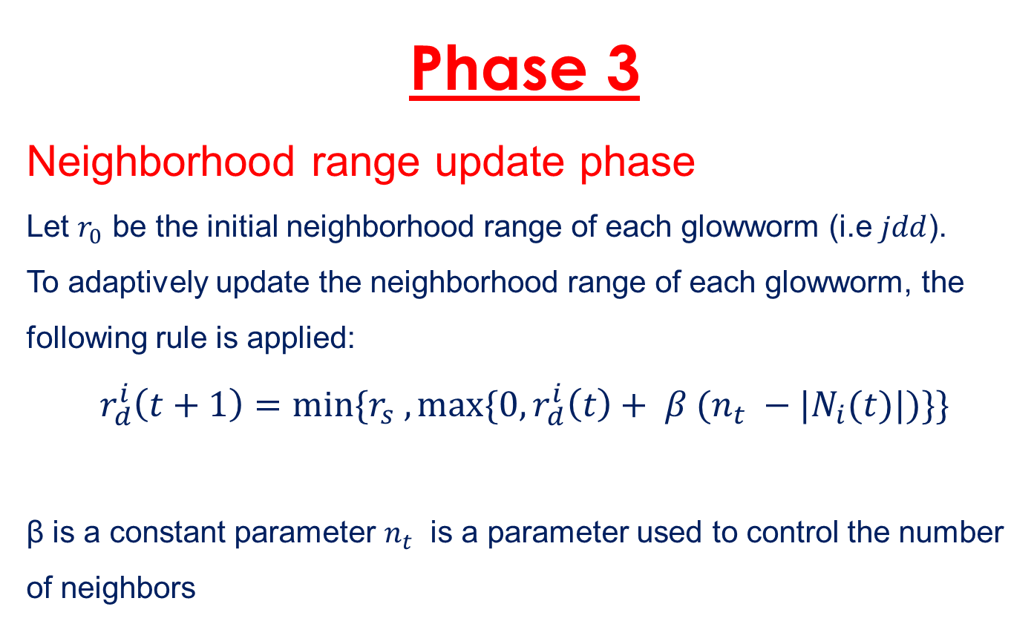
Phase 3
Neighborhood range update phase
Let $r_{0}$ be the initial neighborhood range of each glowworm (i.e $jdd$).
To adaptively update the neighborhood range of each glowworm, the following rule is applied:
$$r_{d}^{i}\left(t+1\right)={min⁡\{r}_{s} ,\max{\{0,r_{d}^{i}\left(t\right)+ β (n_{t} −|N_{i}(t)|)\}\}}$$
β is a constant parameter $n_{t}$ is a parameter used to control the number of neighbors

Slide 12
PYTHON IMPLEMENTATION OF
GLOWWARM SWARM OPTIMIZATION

Slide 13
APPLICATIONS
1. Detecting multiple sources of a general nutrient profile, that is distributed spatially on a two dimensional workspace, using multiple robots.
2. Localization and decommissioning of hostile sensors or transmitters, scattered over a landscape, by sensing signals radiating from them.
3. Glowworm swarm optimization can be applied to solve the multi-constrained (QoS) multicast routing problem (MQMR) problem using an improved encoding method.

Slide 14
4. Chasing Multiple Mobile signal Sources.
5. Rolling bearing fault diagnosis method
6. Solving nonlinear equation systems.
7. GSO can be used to form a multi-robot cooperation strategy for odor sources localization based on a modified GSO algorithm (M-GSO).

Slide 15
References
K.N. Krishnanand, D. Ghose, “Detection of Multiple Source Locations using a Glowworm Metaphor with Applications to Collective Robotics”, Swarm Intelligence Symposium, 2005, pp. 84-91.
Kaipa, K. and Ghose, D. (2017). Glowworm Swarm Optimization
Theory, Algorithms, and Applications. Cham: Springer.
K.N. Krishnanand and D. Ghose. “Kinbots: A mobile robot platform for collective robotics applications,” Technical Report GCDSL/2004/07, Department of Aerospace Engg., IISc, Bangalore, August 2004.
E. Bonabeau, M. Dorigo, G. Theraulaz. Swarm Intelligence: From Natural to Artificial Systems, Oxford University Press, 1999, pp.183-203.
Asha Gowda Karegowda and Mithilesh Prasad “A Survey of Applications of Glowworm Swarm Optimization Algorithm” International Conference on Computing and information Technology (IC2IT-2013)

